Slide 1

The Standard Error of Measurement
Dr Oliver Clark

Slide 2
This Video
An analogy
The Standard Error of Measurement
Confidence Intervals
Standard Error of Difference

Slide 3
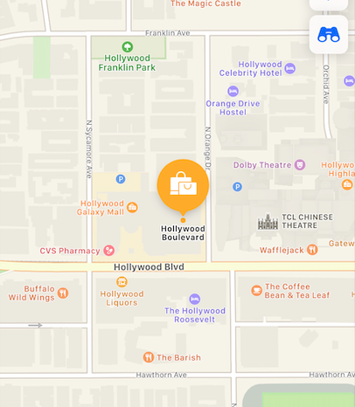
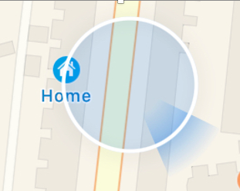
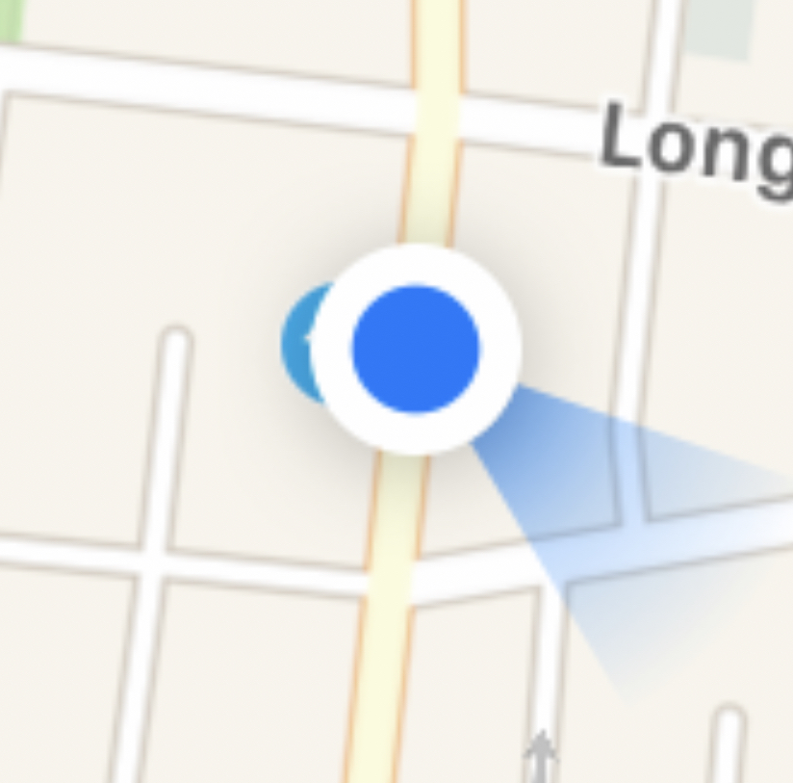
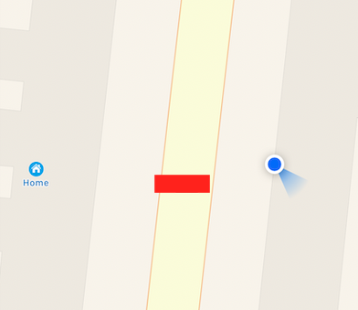
An Analogy

Slide 4
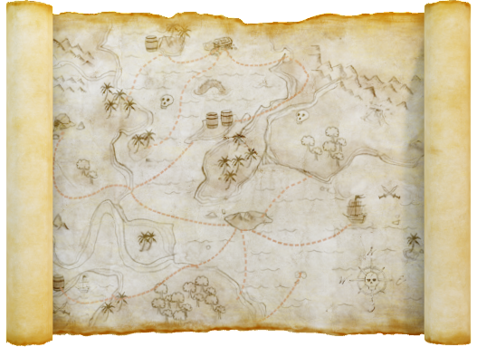
Standard Error of Measurement
Extraversion

Slide 5

Standard Error of Measurement
$SEM=Standard Deviation ×\sqrt{1−Reliability}$
$SEM=SD×\sqrt{1−r_{xx}}$

Slide 6
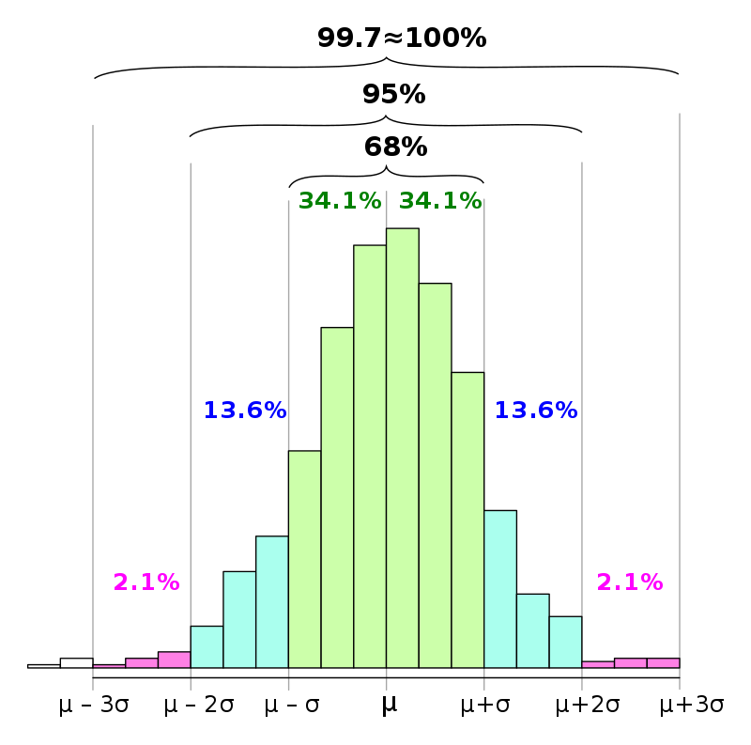
Standard Error of Measurement
Raw score = 4
4
SEM = 0.8
68% of scores between 3.2 and 4.8
95% of scores between 2.4 and 5.6
RS-3SEM
RS-2SEM
RS-SEM
RS
RS3SEM
RS+2SEM
RS+3SEM
3.2
4.8

Slide 7
Reporting Scores with the Standard Error of Measurement
This individual scored 4 out of 7 on the
extraversion scale.
Taking this likely margin of error into account, we can still be fairly confident that the individual’s current score on similar extraversion measures would lie somewhere between 3.2 and 4.8 out of 7
No tool is perfectly accurate in its measurement and we would always expect some margin of error around a score. This is the extent to which the score underestimates or overestimates the individual’s current in the area measured by this test.
4
RS-3SEM
RS-2SEM
RS-SEM
RS
RS+SEM
RS+2SEM
RS+3SEM
3.2
4.8

Slide 8
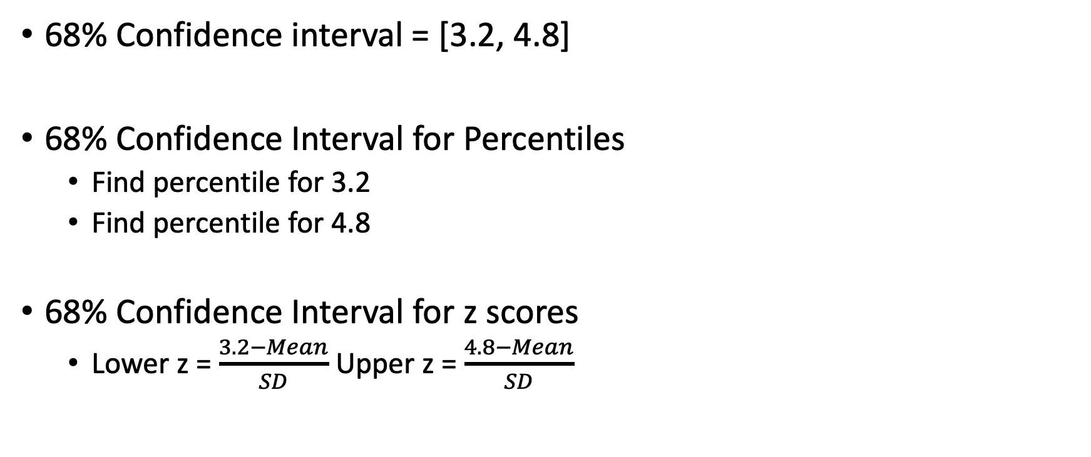
Reporting Scores with the Standard Error of Measurement
68% Confidence interval = [3.2, 4.8]
68% Confidence Interval for Percentiles
Find percentile for 3.2
Find percentile for 4.8
68% Confidence Interval for z scores
Lower z = $\frac{3.2−Mean}{SD}$ Upper z = $\frac{4.8−Mean}{SD}$

Slide 9
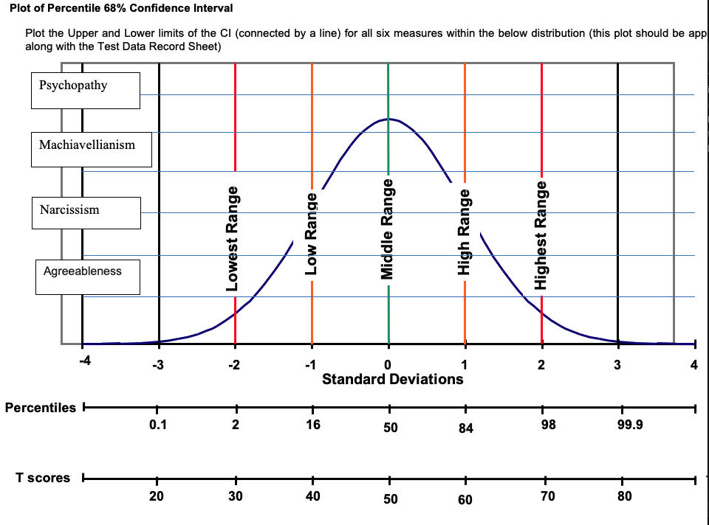
Reporting Scores with the Standard Error of Measurement

Slide 10
More Standard Scores
Scale | Mean | SD | 68% Scores | ‘Limit’
Z | 0 | 1 | -1 to + 1 | -5 to + 5
McCalls T | 50 | 10 | 40 to 60 | 0-100
Stanine | 5 | 2 | 3 to 7 | 1 to 9
Sten | 5.5 | 2 | 3.5 to 7.5 | 1 to 10

Slide 11
More Standard Scores
Z score: Mean = 0, SD = 1
T Score: Mean = 50, SD = 10
How do we get from one to the other?
( Z X 10) + 50 = T

